Slide 1
FLIGHT FARE PREDICTION
Prepared by : Nurfarah Izzati binti Ahmad Yusoff

Slide 2
PROJECT OVERVIEW
PROBLEM STATEMENT
Flight ticket prices can be something hard to guess, today we might see a price, check out the price of the same flight tomorrow, and it will be a different story.
OBJECTIVE
To help airlines and travel industries to set a price system to grow their business
To predict the flight ticket price for users to plan their journey accordingly and select best-suited flight
Note – use APA style referencing for in-text citations (refer to link above)

Slide 3
PROBLEM STATEMENT
https://libguides.nus.edu.sg/APA/intext
Note – use APA style referencing for in-text citations (refer to link above)

Slide 4
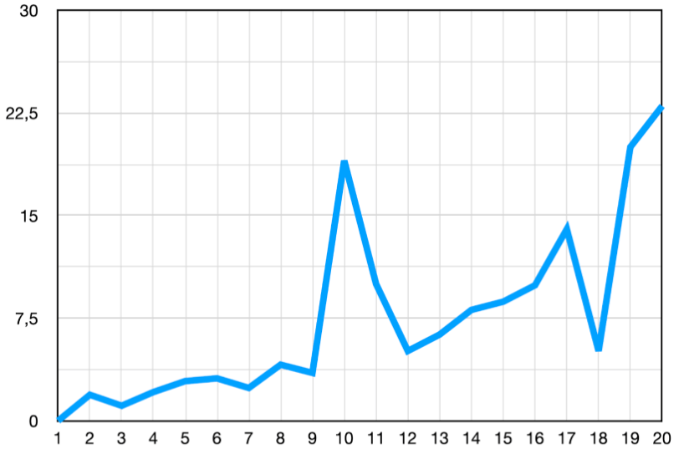
Sub-Title 2
Table 1. Table title
Figure 1. Chart title

Slide 5
Reference
Use latest APA style referencing

Slide 6
Thank you

Slide 7
Appendix

